Slide 1
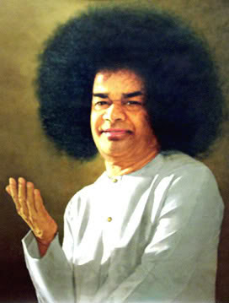
THE QUALITIES OF A SSE TEACHER

Slide 2
SSE TEACHING
Aim of SSE Teaching
Elicit character in each child and is achieved by the integration of Human Values into all aspects of teaching techniques.
Human Values
Teaching Techniques

Slide 3

Qualities of a SSE teacher
Be a role model
Teachers should be the role models for the children and therefore should practise all the Human Values themselves in their day to day life that means 24 hours a day.

Slide 4
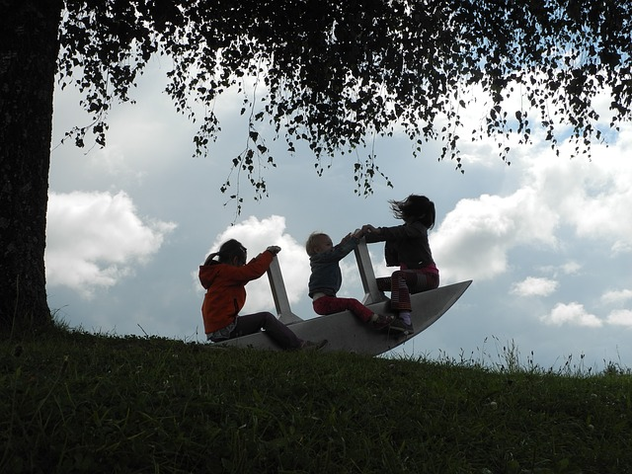
Qualities of a SSE teacher
Environment
We have to provide a safe and happy environment for children.

Slide 5
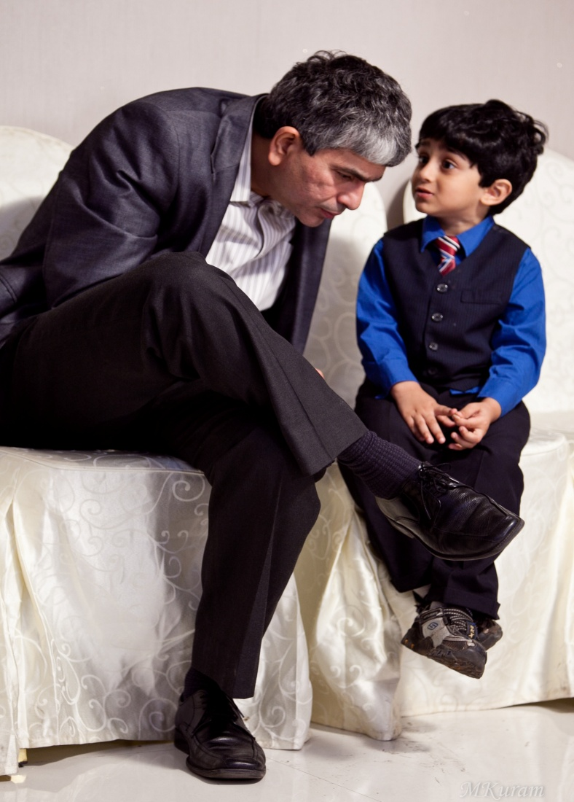
Qualities of a SSE teacher
Understanding
Understanding is the most subtle and so the most powerful form of non-violence.
We must understand at every age, which releases their creativity.

Slide 6
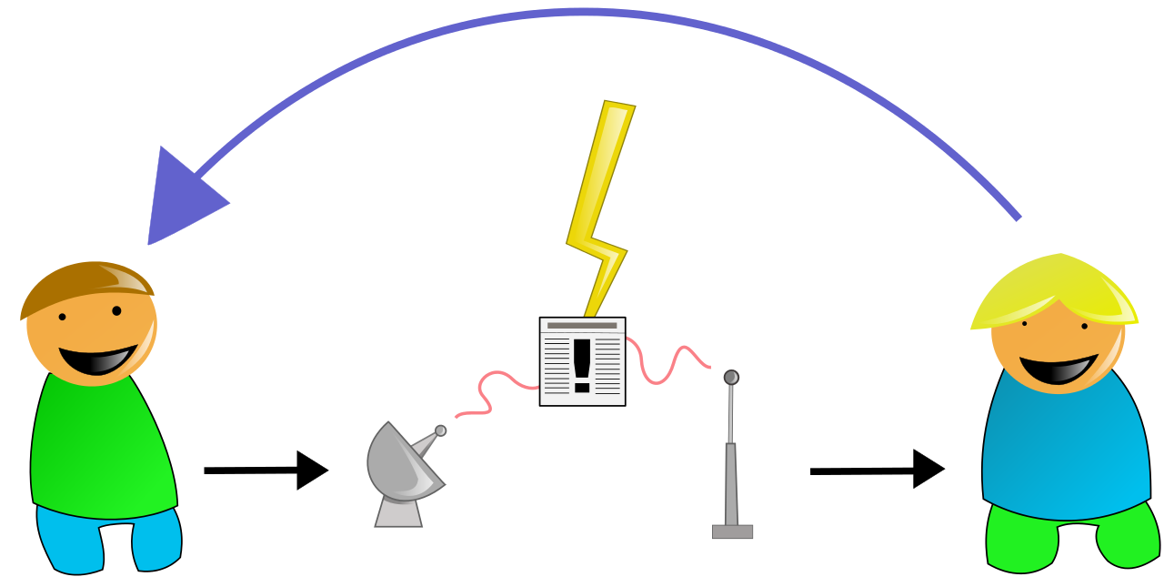

Qualities of a SSE teacher
Clear Communication
Clear communication brings understanding and our actions speak clearly.

Slide 7
Qualities of a SSE teacher
Alignment of words and actions
Thought
Learning, Trust & Love
Word
Action
When our words and actions are aligned learning, trust and love will flow.

Slide 8

Qualities of a SSE teacher
Self-transformation
Teaching Human values in SSE classes should be focussed on self-transformation, which is about quality.
First the teachers have to be transformed then we can transform the children.

Slide 9
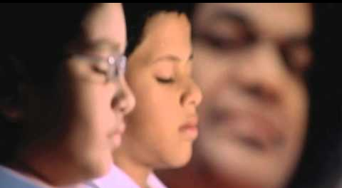
Qualities of a SSE teacher
Caretaker Relationship
Teacher must be a caretaker to the children. The children must believe that teacher is there for them. The relationship should be vital. The teacher should be kind, loving, compassionate and empathetic.

Slide 10
Qualities of a SSE teacher
Moral feeling & action
Teachers should practise moral knowing, information about Human values, awareness of self and others, ethical framework, conscience and moral reflection.
Moral feeling - positive emotion, positive thoughts and capacity to solve the conflict situation.
Moral action - consequences, will power, discipline and mental decision making.

Slide 11
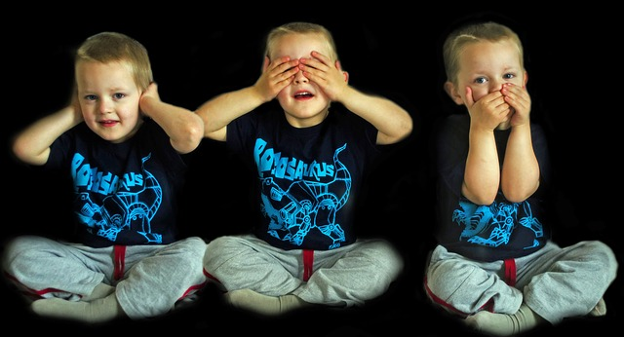
Qualities of a SSE teacher
Mentoring
The teacher must be a mentor and must weed the bad behaviours through loving confrontation to the benefit of the child

Slide 12
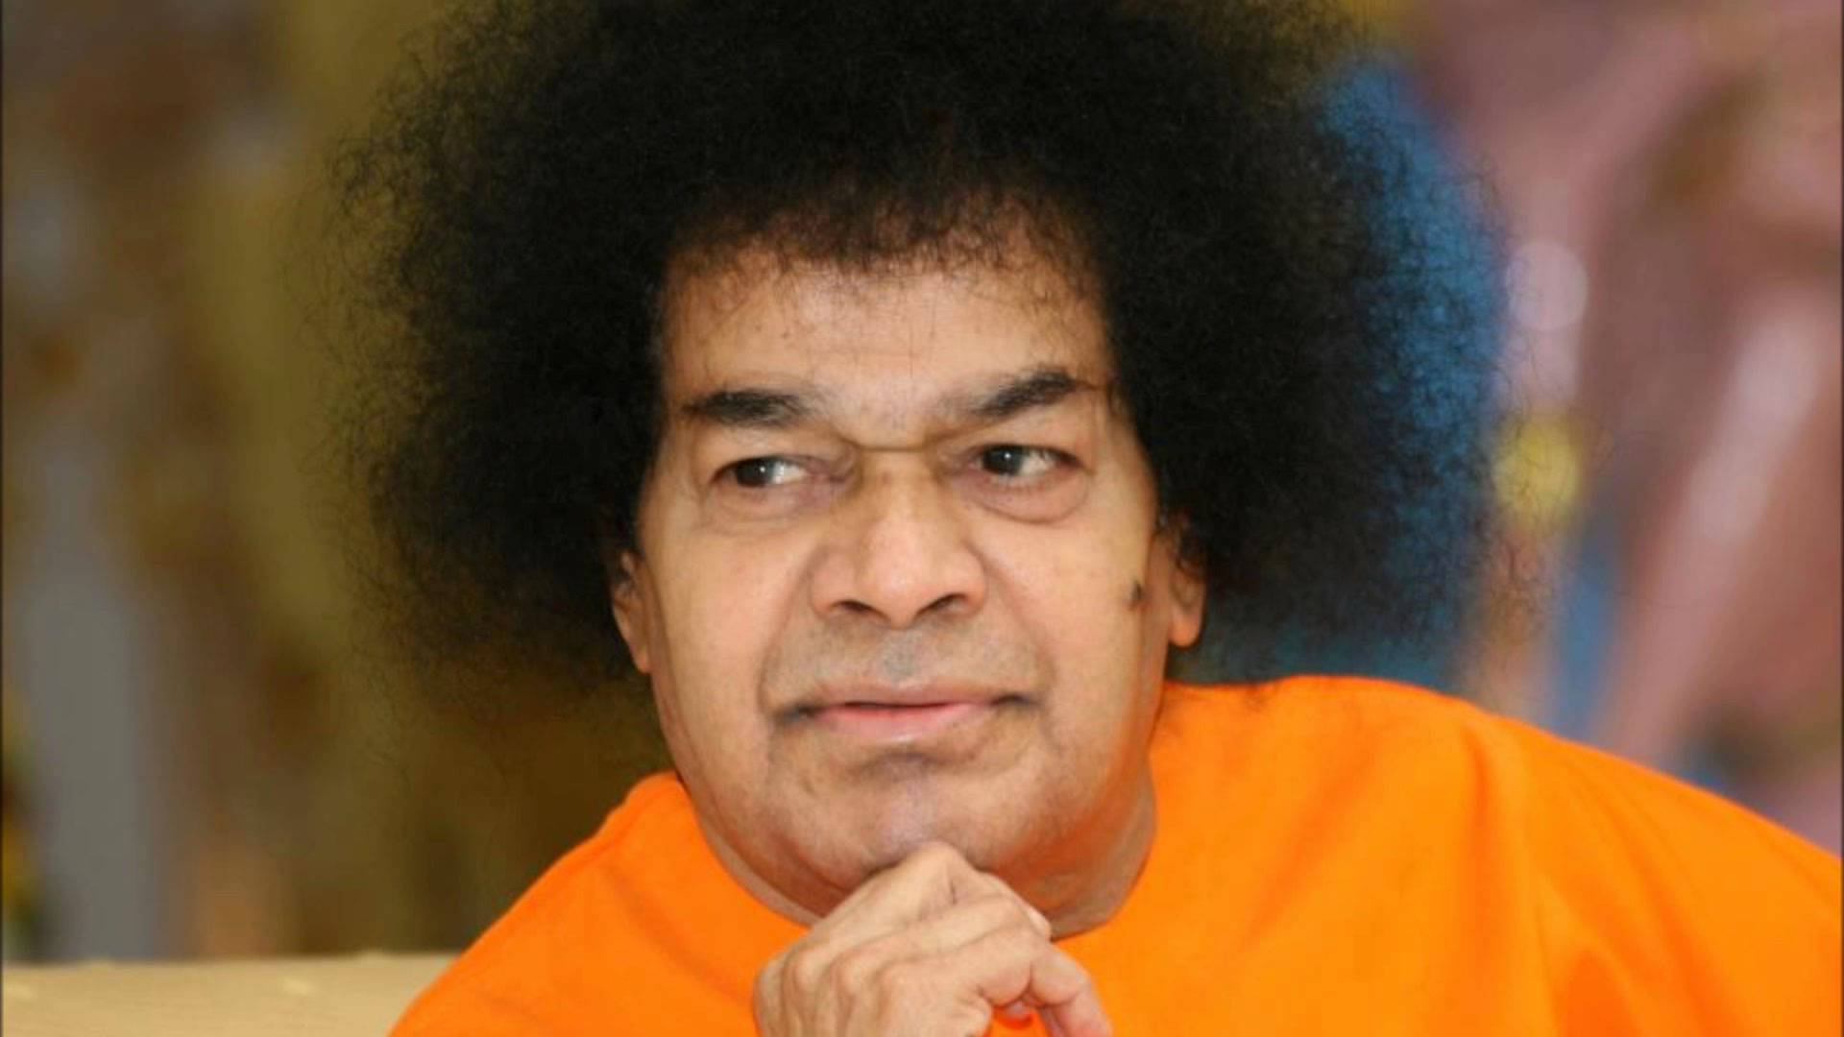
Swami Says
“Teachers are reservoirs from which, through the process of education, students draw the water of life.”

Slide 13

The benefits of the teaching techniques
Mind Maps
There are nine questions under the mind map:
What is it?
How do you feel when you practice the values?
How do others feel?
What does it look like?
What are the benefits?
What are the challenges?
What are the limits?
What are the related values?
What are the opposites?
The above questions make the mind map very effectively

Slide 14

The benefits of the teaching techniques
Affirmation
This is necessary to overcome the negative emotions.
E.g - Be Honest, Believe in yourself

Slide 15

The benefits of the teaching techniques
Formulating questions for the stories
Knowledge - Remembering
Comprehension - Understanding
Application - Applying
Analysis - Analysing
Synthesis - evaluating
Evaluation - Creating

Slide 16

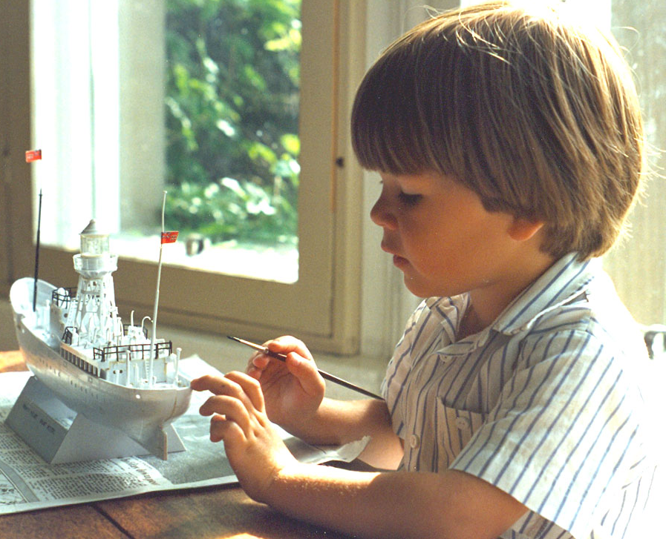
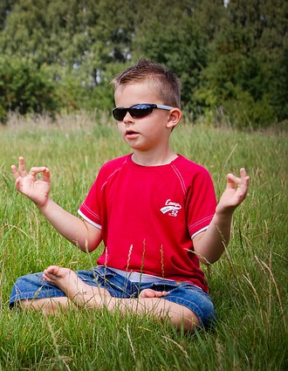
The benefits of the teaching techniques
Benefits of musical intelligence
Creativity, memory and concentration

Slide 17
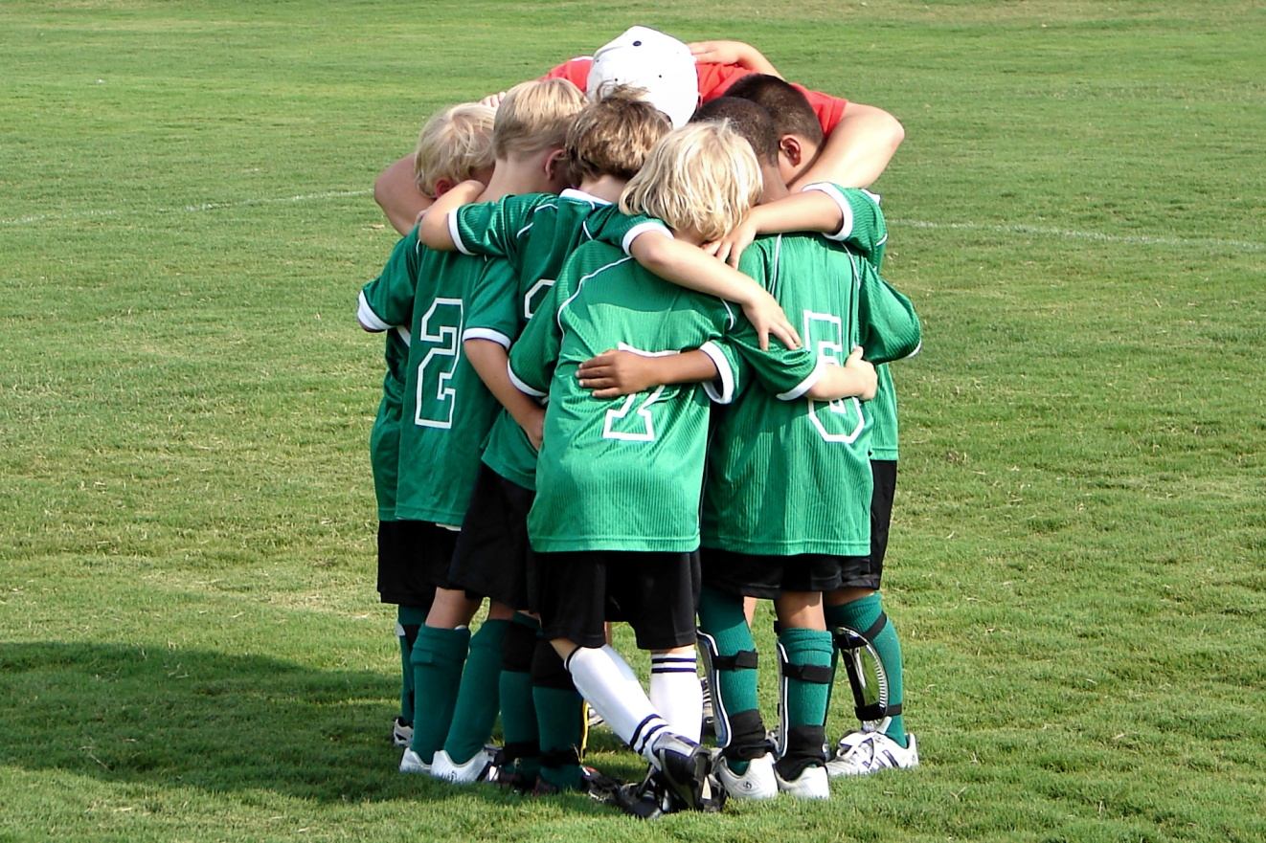
The benefits of the teaching techniques
Benefits of Teamwork
Joy, cooperation, positive emotion and communication both linguistic and interpersonal.

Slide 18

The benefits of the teaching techniques
Creative visualisation
• Experiencing the value, right brain activity, and generation of image, shared experience, occupied and receiving.
• Operational model of the values

Slide 19

The benefits of the teaching techniques
Group Activity
• Social skill
• Self confidence
• Caring and Sharing
• Communicative skills
• Negotiation
• Team skills
• Flexibility and Unselfish

Slide 20
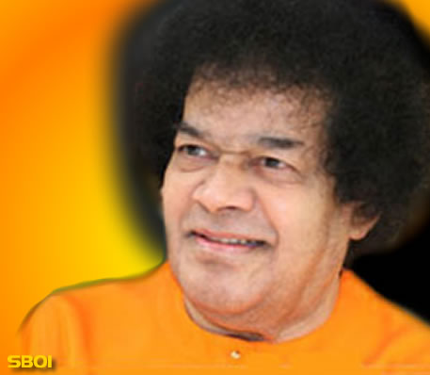
SAIRAM

