Slide 1
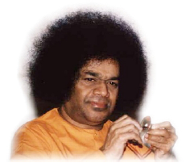
i to I Transformation via Sai Bhajans:
A Guideline / Workshop
San Jose, CA
February 9th 2013

Slide 2
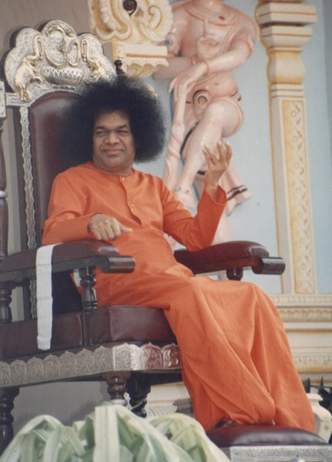
Bhajans – A form of Service
“…The divine vibrations that result from bhajans you sing are spreading to all parts of the world. The divine name that you chant purifies the hearts of many. Sing the glory of God. By doing so you will render great help to the whole world” SSSB, Oct 9, 2002

Slide 3
Region 7 Survey – Your Questions
Segment 1

Slide 4
Region 7 Questions
Group 1 – requests for ideas for management of tasks of a Devotional Coordinator as to how make center devotion program for bhajans universal , inspiring, friendly and open to suggestions/corrections etc.
Group 2 – wants to listen as to how “connection with Swami” is established by students while singing bhajans; Do’s and Don’ts both during and after bhajan singing; exceptions in Bhajan selection
Group 3 – request for Guidelines for the USA centers
Group 4 – wants to learn about the physical interaction and directions received from Swami that helped them improve connection to Swami both during student days ; Also wants to understand the role of a Bhajan Leader along with tips on instruments /percussion support.
Group 5 – wants to know how important is understanding of the lyrics, how to introduce new bhajans, responsibility of a Bhajan leader and Evaluation strategies of a high quality bhajan session
Group 6 – wants to understand criteria to select Bhajans and standard for the format of a bhajan session across US along with Bhajans as a service such as the elderly in convalescent homes

Slide 5
Questions from DC – Group 1
Describe DC role as outlined by guidelines and by Swami with respect to devotion program /Suggest ways to empower Devotion coordinators perform their role.
How to inspire and encourage each center conduct practice sessions at centers prior to bhajan leading in an effort to improve quality?
Should all devotees be encouraged to try to lead bhajans at centers? What are some ways to help new bhajan leaders?
Is there a recommended agenda for a devotional program? That is, specific prayers, bhajan type (Ganesha, Guru, Maa, Krishna, Rama etc.)
Some center members like loud, fast-paced bhajans while others prefer softer melodious ones. At times, the fast bhajan leaders get in a frenzy (with heads bobbing and cymbals/tambourine in rapid activity) - is this what Swami would like to see? Has Swami said anything about the tempo of bhajans? It seems like the fast paced bhajans may induce rajasic tendencies whereas the slower, softer ones promote satvic properties.
Some coaches encourage/urge women to sing in high pitch tones (beyond their comfort level). It is also difficult to follow for others. Is it better to lead bhajans that most people can follow easily or is it better to push oneself beyond limit to accomplish a better way of singing (at least from the coaches’ perspective)?
How to encourage devotees spread their love of music to others – such as the elderly in convalescent homes? Has Swami said anything about bhajans/devotional songs as service (not only within the Sai family but beyond that)?

Slide 6

Questions from Group 2
To hear first person stories and about how bhajan singing was enjoyed by Swami and how singing at Parthi helped them connect to Swami.
Are there any specific Do’s and Don’ts during and after bhajan Singing that Swami wanted and insisted?
How have Bhajans transformed any devotee or student coming to Parthi and why Swami insisted in clapping and group singing?
How to stay connected with Swami now, and if thru bhajans how they should be rendered always?
Is it important to choose bhajans according to one’s voice? How can voice be improved by a novice singer who desires to sing but not young any more?
How can Bhajan singing become a service for the Lead singer and follower? What does Swami say on this?
We hear stories that Swami does not like certain bhajans (Ek Baar Kshama Karo). Is there any reason Swami gave when he stopped certain bhajans? Is there a DO NOT sing list?
Alaaps and crescendos - what does Swami say on this?
Any personal experience that made you chooses bhajan singing as the chosen path for connecting and going towards Swami.

Slide 7
Questions from Group 3
What are Swami's guidelines and disciplines on devotional singing that are followed by the students leading bhajans at Parthi/Brindavan?
What are some teachings/experiences given directly to the students by Swami with regards to bhajans?
What guidelines should the USA centers follow for devotional singing?

Slide 8
Questions from Group 4
Members look forward to hearing stories/anecdotes from the speakers about their personal interaction with Swami and how this has helped them connect better during bhajan singing.
Members also look forward to hearing any particular suggestions that Swami gave them personally regarding leading a bhajan or playing an instrument etc.
Members also wanted to know more about the enchanting bhajans sung by the students at Parthi - any suggestions they have for us regarding playing percussion instruments, manjira etc and would love to hear if they can tell us tips about clapping during the bhajans which makes Parthi bhajans so captivating.
We would also like to hear stories about how they connect to Swami when they are thousands of miles away so that we, in turn, could learn to connect better.
What does it take to be a good bhajan mentor - any personal experiences while they were students at Parthi will be really helpful.
We often hear students talk about their not having any prior training to play instruments but by Swami's Grace had started playing it :). We would love to hear what they did to earn Swami's Grace - take the instrument playing as a Sadhana or Swami guided them in a dream etc.

Slide 9

Questions from Group 5
Role of Bhajan Leader - What does it mean to herself or himself?
Singers to know meaning of what they are singing and correct pronunciation. Can you throw some light on these?
What was Swami's message about how to improve quality of singing bhajans? Any particular guidance Swami gave?
Sometimes, he or show may be very good singer, but cannot connect? Why does this happen?
How about giving opportunity to all interested of instead of engaging only a few? He or she may sing from heart, but may not be best in singing. Singing from heart is important or giving importance to music?
What did Swami say about introducing new bhajans? When children are singing, simple songs should be encouraged, and they can relate. They should understand why they are singing.

Slide 10
Questions from Group 6
What are the criteria to select bhajans? Short vs long, simple vs. complex? Do we need to keep in mind that even though the bhajan is very good musically, it might be difficult for the devotees to follow?
Please provide tips to keep improving on Bhajan singing.
How do we encourage center members to take up leading Bhajans?
Is it okay for Bhajan singers to sing bhajans which do not have the typical Bhajan format that Sai Bhajans has: e.g.: Shirdi Sai Bhajans have a different format.
How strictly should we follow the Overall format of the Bhajans - in terms of 108 Names, Bhajans, Meditation, Arathi?
More questions? – You can add now or at the end of every segment

Slide 11
Set - Objectives for Region 7
Ideas for management of tasks of a Devotional Coordinator as to how make center devotion program for bhajans universal , inspiring, friendly and open to suggestions/corrections etc.
“Connection with Swami” – How is it established while singing bhajans
Do’s and Don’ts both during and after bhajan singing
Exceptions in Bhajan selection
Guidelines for the USA centers
Roles and Responsibility of a Bhajan Leader
Tips on instruments /percussion support
Important ace of understanding of the lyrics,
How to introduce new bhajans,
Evaluation strategies of a high quality bhajan session
Criteria to select Bhajans
Standard for the format of a bhajan session across US
Bhajans as a service to elderly in convalescent homes

Slide 12
Basic building blocks in a Bhajan
Segment 2

Slide 13
Devotional Songs vs. Sai Bhajans
( Ground Rules)
 | Devotional Songs | Sai Bhajans
1 | Sing - Listen style | Lead and Follow style
2 | Specific Singers | All are singers ( some lead – all follow)
3 | Classical, Semi, Light, Very light, Chants | Mostly Light
4 | Attributes oriented | Name oriented
5 | Multiple Paragraphs | One Paragraph
6 | Mostly one speed from start to end | Mostly two speeds from start to end
7 | Audience keen in listening | Audience keen in active participation
8 | Performance based on the quality of the Singer | Performance based on the quality of the Bhajan following

Slide 14
Let us listen to a few Bhajans
Let us listen to a few Bhajans from you all
Raise your hands to volunteer to sing
Sing a bhajan just 4 lines only - once each
This is just an exercise

Slide 15
Classifications of Bhajans
Bhajans in general can be classified into
  Simple
  Medium
  Complex
What does this mean? (From leading and following standpoint)
  Simple – For all the lines of the bhajan, the words sit well on the beat
  Medium – For some lines of the bhajan, the words do not sit on the beat
  Complex – For every line of the bhajan, the words do not sit well on the beat
Speed relating to Simple to Complex -
  Simple –> Speed tends to be Fast – Charged Feel - High Energy/Powerful Bhajans
  Medium –> Speed tends to be Medium – Relaxed feel - Beautiful Bhajans
  Complex –> Speed tends to be Slow – Meditative feel – Sweet/Musical Bhajans
What does this mean? (From leading and following standpoint)
  We need variety ( is spice of life) – We need all types of bhajans ( that is why we never get bored of Bhajans) – However the boundaries of Simple to Medium (or) Medium to Complex can be very thin in some bhajans – depends on the style of singing – However this presentation assumes the style of the original composition as the basis for the classification

Slide 16
Classifications of Bhajans - Samples
Simple | Medium | Complex
Jai Jai Jai Jai Ganapati Deva | Vinayaka Vinayaka | Vigna Vinashaka Gananatha
Every moment of my life | Remind me my Lord | Sai Prem De Shanti De
Satyam Gnana Anantham Brahma | Muralidhara Gopala Madhura | Sai Pita Aur Mata Sai
Panduranga Vittala Jai | Kamala Nethra Sayeeshwara | Jaya Kailasa Pate
Nandakelal Murali Gopal | Sai Bhajan bina Sukh Shanthi | Raghu kula Bhooshana
Dum Dum Dum Dumaru Bhaje | Ram Hare Naam Bolo | Janani Ma Sai Janani Ma
Guru Baba Guru Baba | Hari Om Tat Namashivaya Sai | Premaswaroopini Janani Ma
Jaya Narayana Jaya Hari Om | Shiva (4) SHivaya Nama Om | Jagadashrya Shree Raghu
Hari Om Namo Shiva Shakthi Namo | Jai Sairam Jai Sairam Premavathara Sai Avtara | Araja Suno Mere Parama Kripa
Bhajamana Govinda Gopala | Jagadodharini Mata Durga | Prema Mayi Sai Maa
Bolo Naryana Jai Jai vittala | Hari Narayana Hari Narayana | Pranava Swaroopa Hari om

Slide 17

Sequence of a Bhajan session…
Bhajan – OM and first Bhajan in same pitch
Ganesh Bhajan – should take off smooth and fast
Second, Third Bhajan – Can be slower
Fourth Bhajan to END : speed should increase gradually to high energy bhajans.
Let us remember check mark
Demonstration

Slide 18

Sequence of a Bhajan session –Ideal way
Check Mark
1- 14 Bhajans
Use Mix of categories
Sample Sequence - Choices
  1 – Simple (or) Medium (or) Complex
  2,3,4 – Complex
  6,7,8,9 – Medium
  10, 11, 12, 13, 14 – Simple
  ( Check Mark Slope indicates the “speed decrease” and “speed increase” as well)

Slide 19
“How to” of various aspects of Bhajans
Segment 3

Slide 20
How to choose Bhajans – a quote
“…Leaders in bhajans should realize that many overseas devotees are deeply interested in bhajans are eager to take part in them. The bhajans should be simple and easy for them to follow..” SSSB, April 11, 1997

Slide 21
How to choose bhajans?
Bhajan selection techniques
  Is this suitable to my Voice, Range and Pitch?
  Is this suitable to my accent?
  Is this suitable for our center?
  Is this suitable to the occasion?
    House Bhajans
    Nagar sankirtan
    Regular Center Bhajan
    Yearly Akhanda Bhajan
    Bhajans during service activity
Select “Simple” category of Bhajans if you can follow “Medium” bhajans well and, “Medium” if you can follow “Complex” bhajans well
Complex Bhajans can be chosen only when 50% of the audience (followers) is very very comfortable following the Complex Bhajan even though you can render it extremely well and you could be a professional
Choose a bhajan which you can sing better instead of choosing a bhajan that you like the most

Slide 22
How to practice for singing Bhajans
Individual Bhajan Improvement Cycle
    Selection >>Practice>>Signing>>Feedback
  Where do I select/learn a Bhajan from?
  Is there a list of Beginners Bhajans?
  Is there any vocal exercise to improve my voice?
  How to control my fear when my chance comes?
  How do I know that I am improving?

Slide 23
Who should sing/lead Bhajans?
“…If bhajan is sung in a sweet voice, people will be drawn towards the Lord. Gradually it will be developed into Love for God, and His grace will follow in due course.” -Prasanthi Vahini
"A good leader does not aim to get people to think highly
about himself. He gets people to think highly about
themselves."

Slide 24
Readiness to sing in the center?
Firstly, if you can OK the recorded version of your own Bhajan
Next - Bhajan at your home is Okayed by your family
Next - Bhajans at another person’s house is not commented bad
Next - Practice with Shruthi Sessions /Center group and check if the group approves
Then you are READY to render for the FIRST time
Then render once in 6 months
If people feel like listening to us they will come and ask for us to sing.

Slide 25
How to follow Bhajans?
  How should we follow Bhajans?
    Focus on the words of the Bhajan than the singer
    Focus on Clapping than mere listening to the bhajan
    Focus on the deity of the Bhajan and think of HIM
    Focus on enjoying the music but follow the bhajan to the extent you can hear yourself.
    Focus on the lord or deity of your heart
    The lead singer should focus on singing the bhajan to invoke devotional feeling in the audience than demonstrating that he or she has learnt Classical music otherwise it becomes a big distraction.

Slide 26
How to render this Bhajan?
“How to” and “How Not to” render a Bhajan?
  Demonstration
  What makes the “connection with Swami” happen?
    How can the bhajan leader feel the connection to Swami?
    How can we think that bhajan followers are able to feel the connection?
    Is this an imagination of the bhajan leader or the bhajan follower?

Slide 27
How to learn a new bhajan?
  Check if New Bhajans are easy to follow
  Learn the bhajan – Get the lyrics; get the tune recorded; play the tune in your car many times and do not sing with the lead singer
  Practice with help – Try to recall the tune from memory
  Try to recall the words from memory
  If you memorize you will more control on the delivery of a new bhajan
  Record your singing of the Bhajan and check at your own home bhajans
  Check if your family likes it
  Practice with fellow lead singers
  If approved by DC, then render in the center
  Teach SSE Children only those NEW bhajans sung in the center – preferably “Simple”, Medium” bhajans

Slide 28
English/Spanish Bhajans
Easy to understand
Typically, easy to sing
Reflective of local setting
Ease for unison singing
To be sung with right instrumental support

Slide 29
Bhajan Session - Exceptions
When to sing Alaps/Introduction to Bhajans and when not to
Why bhajans with words such as “Forgive me” or “Kshma Karo” are to be avoided?
Why cant we sing long bhajans with 8 lines twice in First speed and once in second speed
When to Stop repeating high pitched lines and making them into short lines and repeating them
When do take crescendos - what does Swami say on this?
Notes:
Bansidara Kanaiyya

Slide 30
Instrumental/ Percussion Support for Bhajans
Segment 4

Slide 31
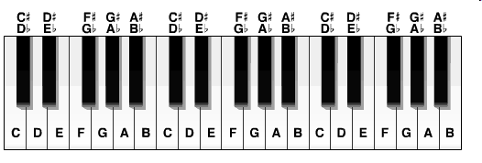
Bhajan Session - Role of Harmonium
  About the Harmonium Keys – You can check your own scale
  Bhajan Practice session at Sai Center -
    Average Base Scale range for men - 6, 7, 1, 2 - A, B, C, D
    Average Base Scale range for women - 3, 4, 5, 6 - E, F, G, A
  How can a Harmonium player help a singer to do his best?
  Note down the scale this time and find the range of voice of the singer
  Harmonium players must know at least one of the shruthi/scale notations : Western or Eastern
  During Bhajan sessions – what role Harmonium player must play?

Slide 32
Practicing with the Harmonium
Harmonium as a tool
Choosing Bhajans in your range
Confidence comes from practicing
Examples (Manamohana Nandalal, Koti Pranam, Shambho Mahadeva Mallikarjuna)
General Recommendations
List 20 bhajans
Singing without lyrics
Record and listen to yourself
Listen, listen, listen and listen more….

Slide 33
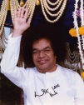
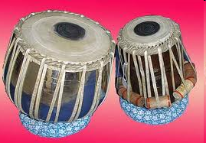
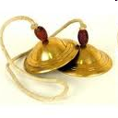
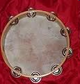
Bhajan Session - Role of Percussion
How Bhajans will be if no Talam support was there?
What are different types of Talams we play in Sai Bhajans
How do we decide to play the different types of beats?
How should the Talam support be in the overall bhajan session between Tabla, Kanjira( Duffli) and Manjira
Notes:
Bansidara Kanaiyya

Slide 34
Bhajan Experiences & Best Practices
Segment 5

Slide 35
Bhajan Experiences (Personal)
Bhajan One - Experience at Physical Presence
Bhajan Two - Experience in his Omnipresence
( Each Presenter – shares the above)

Slide 36
Best Practices
Duty ( Individual Level)
Verify if you can sing - How?
  Practice at your own home, house bhajans & center
  Record while following and hear them
  Sing a bhajan that is sung in the center
Arrive early for the bhajan practice on Bhajan day
Singer could memorize the bhajans
Choose a bhajan which you can sing better instead of choosing a bhajan that you like the most

Slide 37
Best Practices
Discipline ( Community Level/ center level)
Brief and effective ( remember 50%)
Should know when to stop
Emphasizing Universality in Bhajans
Twice in the First Speed and Once in Second speed
Long Bhajans with long lines and more than 8 lines – sing some lines only once
High Pitch line of a Bhajan in Speed 2 should NOT be sung twice.
Format of the bhajan session should be as decided by the center

Slide 38
Best Practices
Devotion (Between Swami and You )
Understand the words and communicate
Talking in music is communication or Bhava
What is not devotion as per Swami?
  Singing to please someone else is NOT devotion;
  Singing thinking of ONE AND ONLY THE DIVINE is devotion

Slide 39
Review of Questions
Closing Segment

Slide 40
Review of Questions….
Questions from Group 1
Questions from Group 2
Questions from Group 3
Questions from Group 4
Questions from Group 5
Questions from Group 6

Slide 41
Objectives for Region 7 - Met?
Ideas for management of tasks of a Devotional Coordinator as to how make center devotion program for bhajans universal , inspiring, friendly and open to suggestions/corrections etc.
“Connection with Swami” – How is it established while singing bhajans
Do’s and Don’ts both during and after bhajan singing
Exceptions in Bhajan selection
Guidelines for the USA centers
Roles and Responsibility of a Bhajan Leader
Tips on instruments /percussion support
Important ace of understanding of the lyrics,
How to introduce new bhajans,
Evaluation strategies of a high quality bhajan session
Criteria to select Bhajans
Standard for the format of a bhajan session across US
Bhajans as a service to elderly in convalescent homes

Slide 42
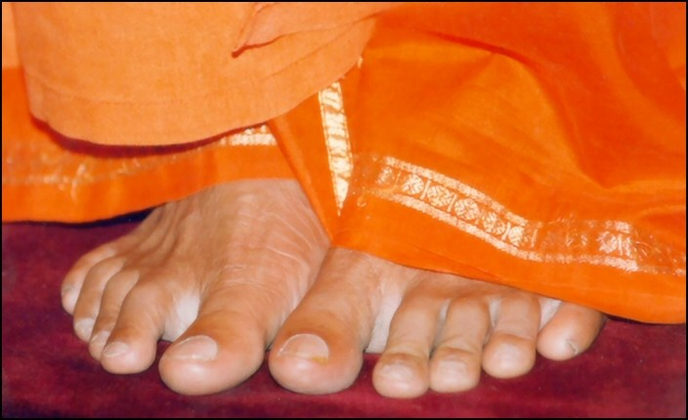
Offering at thy lotus feet…
In this Journey of i to I

