Slide 1
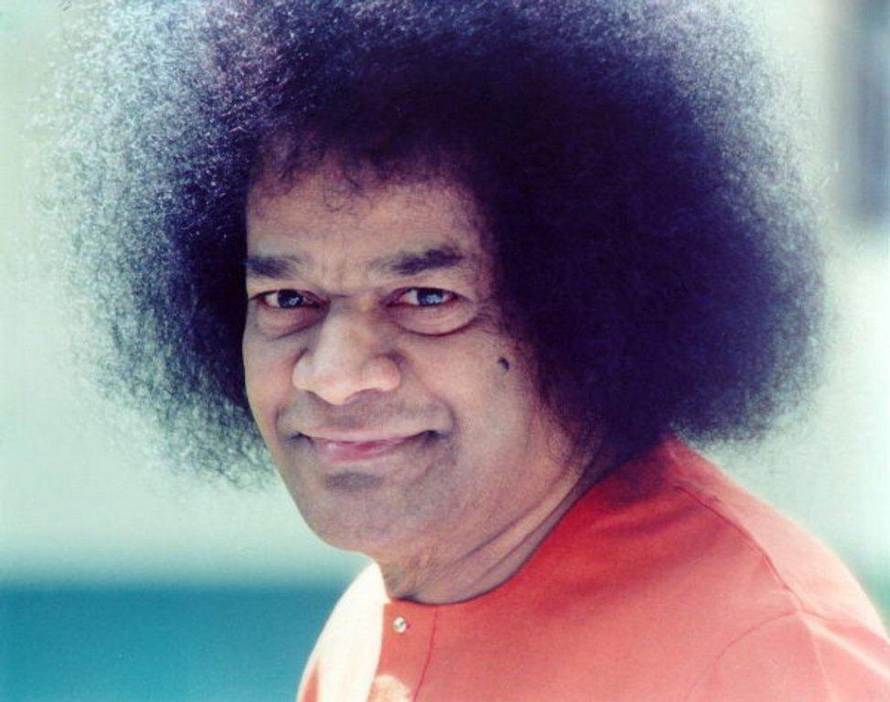
Sacramento Sai Center GAB 2013

Slide 2
UNISON
Om Saiyeshwaraya Vidmahe Sathya Devaya Dhimahe
Tanna Sarva Prachodayat
Next – Unison - Lord Gave the World

Slide 3
UNISON
The Lord gave the world such a beautiful sound Om Om Om Hari OM (x2)
Hari Om Hari Om, Hari Om Hari Om
Om Om Om Hari Om (x2)
From the silence of nothing the Lord gave a word Om Om Om Hari Om (x1)
From the sound of God came this beautiful world Om Om Om Hari Om (x1)
Hari Om Hari Om, Hari Om Hari Om
Om Om Om Hari Om (x2)
2nd Speed
Next – Ladies – Ganesha Ganesha (D# Major)

Slide 4
LADIES LEAD
Ganesha Ganesha Sweet Lord Ganesha (x2)
Please bless the prayers we offer to You
Please bless the prayers, May they please You
Ganesha Ganesha
Ganesha Ganesha
Ganesha Ganesha (x2)
2nd Speed
Next – Unison – Lord We are One (D#M)

Slide 5
UNISON
Lord We are One, We are One, We are One
Sai We are One We are all One
Lord We are One We are one We are One
Sai We are one We are one with You (x2)
Next – Gents – We are Blessed (D# Major)

Slide 6
GENTS LEAD
We are Blessed (x3) Sai Baba is
Watching over us (x2 first speed)
We are Here to Sing Your Sweet Name
Let the Light of Your Glory shine on us
Bless us All with Your Presence Gurudev
We are Blessed (x3)
No more tears, No more sorrow, No more death
Sai banish the darkness with Your Love
We are born in the Golden Age of Sai
And we receive the Love Divine (x2)
2nd Speed - Unison
Next – Unison – We are all One (D#M)

Slide 7
UNISON
We are all One
We are all One
We are all One
Sai We are one We are one with You (x2)
Next – Gents – You are My Mother (D#M)

Slide 8
You are my mother, You are my father
You are my nearest kin, You are my dearest Friend
You are my mother, You are my father
You are my nearest kin, You are my dearest Friend
You are my wisdom, You are my treasure
You are my wisdom, You are my treasure
You are my Everything You are my dearest Lord
You are my Everything You are my dearest Lord
tvamEva mAthA, pithA tvamEva
tvamEva bandhusca, sakhA tvamEva
tvamEva vidyA, draviNam tvamEva
tvamEva sarvaM, mama dEva dEva
tvamEva sarvaM, mama sAi dEva
(2nd Speed – Unison all lines once)
Next – Holy Chant - Ashem Vohu (D#M)

Slide 9
LADIES LEAD
Ashem Vohu Vahishtem Asthi,
Ushta Asthi, Ushta Ahmai,
Hyat Ashai Vahishthai Ashem
Next – Gents – Let me be One with the Infinite son (D#M)

Slide 10
Let me be one with the Infinite
sun, forever, forever, forever
Let me be one with the Infinite
sun, forever, forever, forever
Let me be one with the Infinite sun,
forever, forever, forever
Ku-wa-ke, Le-no-Le-no, Ma-O-te,
Hi-a-no, Hi-a-no, Hi-a-no (3X)
(Repeat Above 2nd and 3rd Speed)
Slow Speed….Let Me One with the infinite sun (1x)
Next – Unison Alternate – We are All One (D# Major)

Slide 11
UNISON ALTERNATE
We are all One
We are all One
We are all One
Sai We are one We are one with You (x2)
Next – Ladies – Know that the Lord (D# Major)

Slide 12
LADIES LEAD
Know that the Lord is sweetness itself
Everything is a sign of His grace (x2)
He is the nearest, He is the dearest
born in the world as Sri Sathya Sai
Hold onto Him as close as you can
Knowing Him as an intimate friend (x2)
Next – Unison Alternate –Hallelujah(D#Major)

Slide 13
UNISON ALTERNATE
Hallelujah
Hallelujah
Hallelujah
Hallelujah Hallelujah (x2)
Next – Gents – He is Love (D# Major)

Slide 14
GENTS LEAD
He is Love, so learn to love
He is Truth, so be true
He is Peace, so work for peace
He is Good, so be good
He is Lord, His Name is Sai
Sai Ram, Sai Ram (x2)
Sai Ram, Say Sai Ram (x2)
Next – Unison Alternate – Hallelujah Hallelujah (D# Major)

Slide 15
UNISON ALTERNATE
Hallelujah Halelu Hallelujah
Hallelujah Hallelujah
Hallelujah Halelu Hallelujah
Hallelujah Hallelujah (x2)
Next – Kyrie(D# Major)

Slide 16
GENTS LEAD
Kyrie Eleison Kyrie Eleison
Christe Eleison Christe Eleison
Kyrie Eleison Kyrie Eleison
Next – Unison Alternate – Adoramus Te Christe (D# Major)

Slide 17
UNISON ALTERNATE
Adoramus Te Christe (x3)
Kyrie Eleison
Adoramus Te Christe (x3)
Kyrie Eleison
Kyrie Kyrie Eleison (x3)
Kyrie Eleison
Kyrie Kyrie Eleison (x3)
Kyrie Eleison
Adoramus Te Christe (x3) Kyrie Eleison
Kyrie Kyrie Eleison (x3) Kyrie Eleison
(2nd Speed repeat unison) (x3)
Next – Unison Together – We are All One / Lord We are One (D# Major)

Slide 18
UNISON TOGETHER
We are all One
We are all One
We are all One
Sai We are one We are one with You (x2)
Lord We are One, We are One, We are One
Sai We are One We are all One
Lord We are One We are one We are One
Sai We are one We are one with You (x2)
Next –Gents – Father We Adore you (D# Major)

Slide 19
Father We adore YOU
We lay our lives before You
How We Love YOU
Oh my Sweet Jesus
YOU gave Your Life to save us
How you must love us
Swami We implore you
Restore our lives and make them new
How we love you
YOU know we love you
(2nd Speed repeat)
Next –Unison – Hallelujah Halelu (D# Major)

Slide 20
UNISON
Hallelujah Halelu Hallelujah
Hallelujah Hallelujah
Hallelujah Halelu Hallelujah
Hallelujah Hallelujah (x2)
Next – Unison – Holy Chant – Bismillah Ar-Rahman (D# Major)

Slide 21
GENTS LEAD
Bismillah Ar-Rahman Ar-Rahim (x3)
La ilaha illallah, Allah Allah (x4)
Next – Unison Alternate – Allah Allah (D# Major)

Slide 22
Allah Allah my inner Light
Allah Allah inspiring Sight (x2)
Allah O Akbar (x3)
Allah Allah my inner Self
Allah Allah my Goal in life (x2)
Allah O Akbar (x3)
(Fast) Allah Allah my inner Self
Allah Allah my Goal in life (x4)
Allah O Akbar (x3)
Allah O Akbar (x6)
Next – Unison Together – Lord We are One We are all One (D# Major)

Slide 23
UNISON TOGETHER
Lord We are One We are One We are One
Sai We are One We are all One
Lord We are One We are one We are One
Sai We are one We are one with You (x2)
We are all One
We are all One
We are all One
Sai We are one We are one with You (x2)
Next – Ladies – Let our Hearts Reflect (D# Major)

Slide 24
Let our hearts reflect Thy light Lord
As the Moon reflects the light of the sun
in Love, Always in Love (x2)
Hu Allah Allah Hu Allah Hu Allah Allah Hu (x2)
Let our hearts reflect Thy light Lord
As the Moon reflects the light of the sun in Love, Always in Love (x2)
Hu Allah Allah Hu Allah Hu Allah Allah Hu (x3)
Next –Unison Together : Hallelujah Halelu Hallelujah Hallelujah (D# Major)

Slide 25
UNISON TOGETHER
Hallelujah Halelu Hallelujah
Hallelujah Hallelujah
Hallelujah Halelu Hallelujah
Hallelujah Hallelujah (x2)
Hallelujah
Hallelujah
Hallelujah
Hallelujah Hallelujah (x2)
Next –Holy Chant – Sh'ma Yis-ra-eil(D# Major)

Slide 26
LADIES LEAD
Sh'ma Yis-ra-eil, A-do-nai E-lo-hei-nu,
A-do-nai E-chad.
Next – Gents – Shalom Haverim (D# Major)

Slide 27
Shalom Chaverim Shalom Chaverim
Shalom Shalom Lehi Tra'ot Lehi Tra'ot Shalom Shalom Glad tidings we bring of peace on earth,
good will towards men Of peace on earth, of peace on earth,
good will towards men
Shalom Chaverim Shalom Chaverim
Shalom Shalom Lehi Tra'ot Lehi Tra'ot Shalom Shalom (x3)
Next –Unison Together– We are All One/ Lord We are One (D# Major)

Slide 28
UNISON TOGETHER
We are all One
We are all One
We are all One
Sai We are one We are one with You (x2)
Lord We are One, We are One, We are One
Sai We are One We are all One
Lord We are One We are one We are One
Sai We are one We are one with You (x2)
Next –Unison – Ivdu Haschem (D# Major)

Slide 29
UNISON
I’v du Hashem B'simcha (x4) Come and serve the Holy One
with joy (x4)
Yi dy da dy dy Yi dy da dy dy dy
Yi dy da dy dy Yi dy dy Yi dy da dy dy Yi dy da dy dy dy
Yi da dy dy dy dy dy (2nd speed –x2)
Next –Unison Together – Hallelujah Halelu – Lord We are One (D# Major)

Slide 30
UNISON TOGETHER
Hallelujah Halelu Hallelujah
Hallelujah Hallelujah
Hallelujah Halelu Hallelujah
Hallelujah Hallelujah (x2)
Lord We are One, We are One, We are One
Sai We are One We are all One
Lord We are One We are one We are One
Sai We are one We are one with You (x2)
Next –Unison Holy Chant – Namo tassa (D# Major)

Slide 31
LADIES
Namo Tassa Bhagavato Arahato
Samma Sambuddhassa (x3)
(UNISON)
Buddham Sharanam Gachchami
Dhammam Sharanam Gachchami
Sangham Sharanam Gachchami
Next – Ladies – Namo Amitofu (D# Major)

Slide 32
Namo Amituofo (x2)
Amituofo Amituofo
Namo Amituofo
Namo Quasa Enpusa (x2)
Quasa Enpusa Quasa Enpusa
Namo Quasa Enpusa
Namo Sathya sai baba (x2)
Sathya sai baba Sathya sai Baba
Namo Sathya sai baba
(repeat 2nd speed unision)
Next –Unison Together– Lord We are One/Hallelujah Halelu (D# Major)

Slide 33
UNISON TOGETHER
Lord We are One, We are One,
We are One
Sai We are One We are all One
Lord We are One We are one
We are One
Sai We are one We are one with You (x2)
Hallelujah Halelu Hallelujah
Hallelujah Hallelujah
Hallelujah Halelu Hallelujah
Hallelujah Hallelujah (x2)
Next –Unison – Hey Amba Hey Amba (D# Major)

Slide 34
Hey Amba Hey Amba Hey Amba Bol
Iswar Sat Chit Anand Bol
Samba Sadasiva (x3) Bol
Kaarka preraka jagapati Bol
Amba Amba Hey Jagadamba
Akhilandeswari Jaya Jagadamba (x5)
(repeat 2nd speed)
Next –Unison Om Mani Padme Hum(D# Major)

Slide 35
Shanti
Om Mani Padme Hum
Om Mani Padme Hum
Shanti
Om Mani Padme Hum
Jewel in the Lotus
Lotus of the Heart
Om Mani Padme Hum
Om Mani Padme Hum
Om Mani Padme Hum
Om Mani Padme Hum

Slide 36
Sacramento Sai Center GAB 2013

Slide 37
UNISON ROUNDS
We are opening up in sweet surrender
To the luminous Love light of the Lord
(x2)
We are opening, We are opening (x2)
Ladies:
We are opening up in sweet surrender
To the luminous Love light of the Lord(2)
We are opening, We are opening
We are opening, We are opening
We are opening, We are opening
We are opening, We are opening
Gents:
We are opening up in sweet surrender
To the luminous Love light of the Lord(2)
We are opening, We are opening
We are opening, We are opening
Repeat Above 2nd Speed
Next – Unison – Holy Chant – Kyrie Kyrie (D# Major)

